Slide 1

Automated Diagnosis of Thorax Diseases using Chest X-ray Images
ML group 8
Yuting(Eva) Gu
Sijun(Sunny) Zhang
Saifullah(Saif) Soliman

Slide 2
Outline
Introduction
Method
Data Acquisition & Processing
Unsupervised
Autoencoder & Clustering
Supervised
ResNet50
ViT
Result
Discussion

Slide 3

Introduction

Slide 4
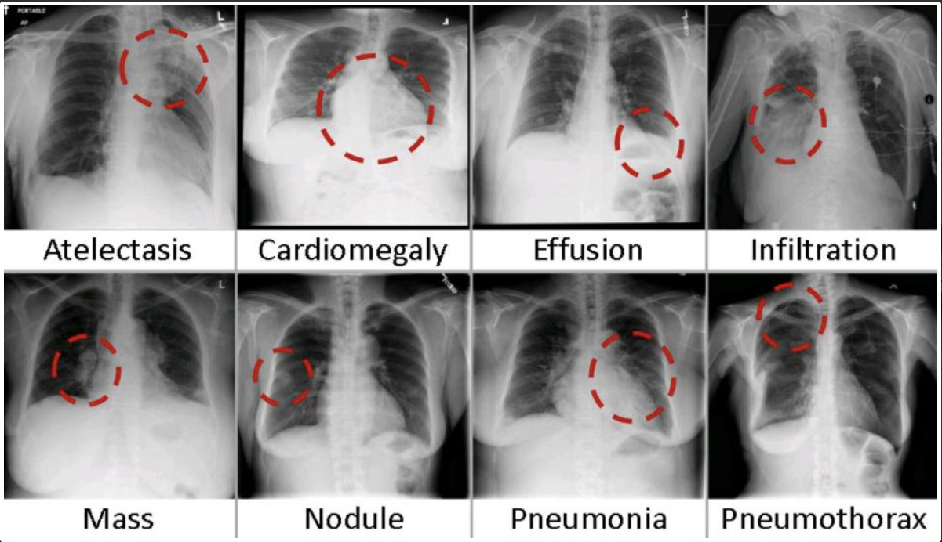
Background
ChestX-ray14 database contain 112,120 frontal-view X-ray images annotated with 14 thoracic disease labels
Valuable resource for training and testing multiclass classification models for thoracic disease diagnostics
Multiclass classification tasks were performed using different CNN models, with ResNet50 emerging as the best-performing model
Vision transformers (ViTs) have recently emerged as a superior approach, surpassing CNNs in performance for image classification tasks

Slide 5
Objectives
Conduct a comparative analysis between the ResNet50 and ViT models for supervised multi-class classification tasks using ChestX-ray14 database
Explore an unsupervised approach by applying an autoencoder method to extract latent representations from the ChestX-ray14 images.
Employ autoencoder and clustering techniques on ChestX-ray14 images to unveil latent patterns and groupings within the dataset
Gain a comprehensive understanding of the strengths and limitations of each approach in thoracic disease identification and image analysis tasks.

Slide 6
Methodology

Slide 7
Data Source & Data Acquisition
Data Source:
ChestX-ray14, which contains frontal-view X-ray images of 30,805 patients with normal chest condition or with one or multiple of 14 thoracic issues (1992-2015)
Data Acquisition:
Images and labels could be downloaded from https://paperswithcode.com/dataset/chestx-ray14

Slide 8
Data processing & model plan
All X-Ray Images (112120)
exclude all AP images
PA X-Ray Images (67310)
Testing Set (11096)
Validation Set (6812)
Training Set (49402)
Autoencoder
…
…
Normal
61.5%
Diseases 38.5%
binary classification
Note: the multi-class model uses 8 processed disease labels the rather than the original 14 disease labels
Fluid Overload
multi-class classification
Infection
…
Notes:
Mention about datasize is not very big and we considered data augmentation but since X-ray has specific position requirement, any data augmentation such as flip or shift or rotation would produce difference meaning, we decide do not do any data augmentation. This decision can also supported by this article: https://www.frontiersin.org/articles/10.3389/fmed.2021.629134/full

Slide 9
14 original disease labels 8 new disease labels
Note: the numbers are for the training set
Grouping
Fluid Overload (4375)
Effusion 95.9%
Emphysema 44.4%
Parenchymal Disease (1701)
Edema 4.14%
Fibrosis 55.6%
Consolidation 12.2% (987)
Infection (8100)
Mass 44.3%
Mass-Like Lesions (5140)
Infiltration 82.7%
Nodule 55.7%
Pneumonia 5.1%
Remain as they were
Remove
Cardiomegaly (988)
Pleural Thickening (1515)
Hernia (112)
Pneumothorax (1645)
Atelectasis (3833)

Slide 10
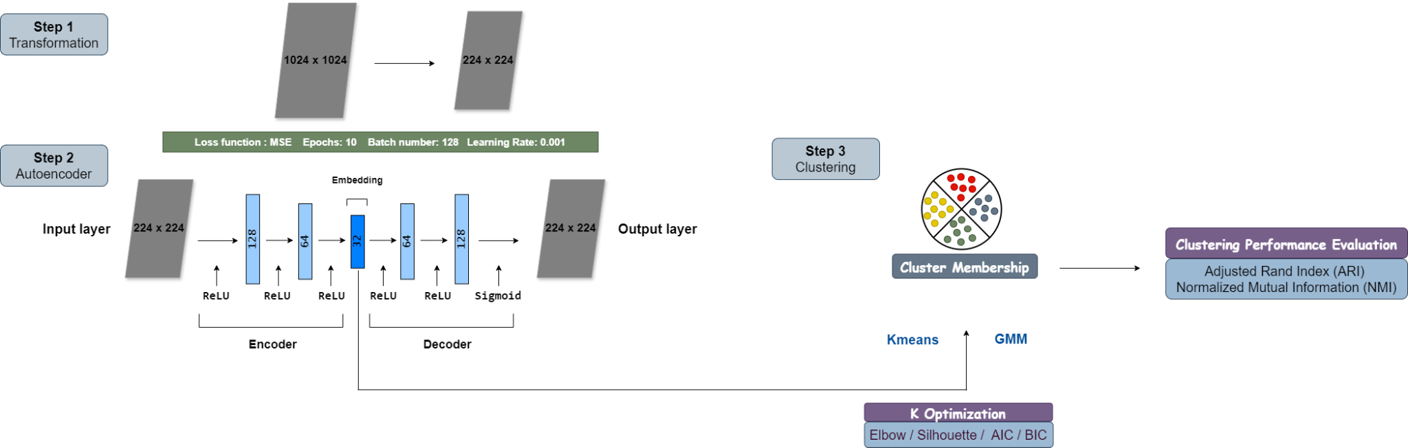
Unsupervised - Autoencoder & Clustering
Notes:
Maybe not read the number, just say we reduce image dimensions

Slide 11
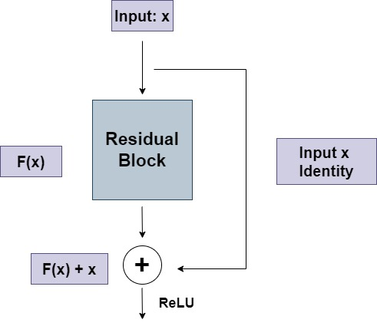
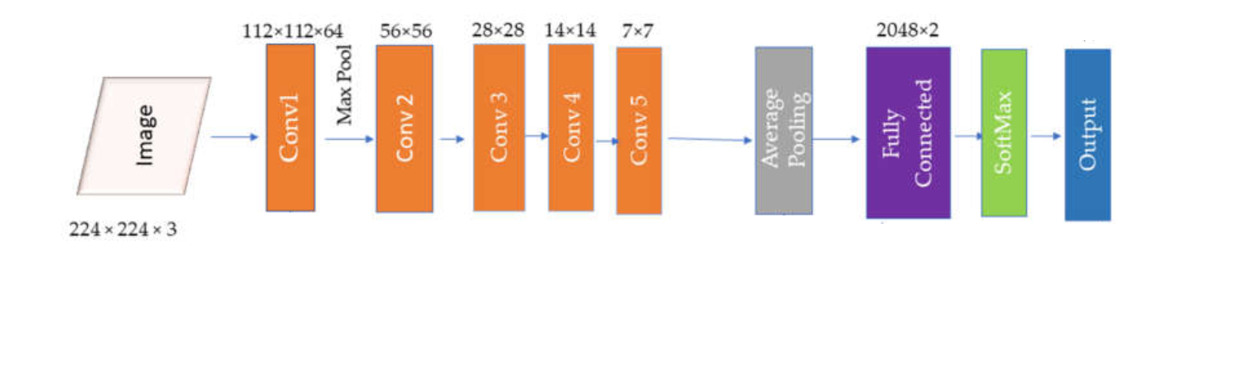
Supervised - ResNet 50
ResNet50 - a 50-layer convolutional network for effective image classification, published in 2015.
Based on the general CNN structure - convolutional layers, pooling layers etc.
What’s special -
ResNet50 incorporates residual blocks where layers learn additional features from the input.
These enhancements are added back to the block's original input to generate the block’s output.
While preserving the deep network structure, it facilitates a stable gradient flow and prevents gradients from vanishing.
the Residual Block
General ResNet50 structure

Slide 12
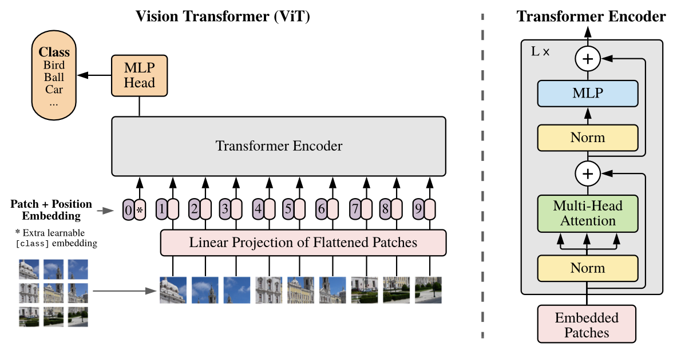
Supervised - Vision Transformer (ViT)
SOTA method for image classification task
Transformer was originally designed for NLP task, then the idea was adapted for computer vision task in 2020 by treating images as a sequence of patches.
Not a RNN model, use self-attention mechanism to capture spatial relationship between patches without sequential processing
Our Model
base ViT with 16 patch size
1024 -> 224 (input size of ViT)
number of classes:
binary (Normal vs Diseases)
grouped multiple classes
Notes:
As shown in the following model structure plot, the original picture shown on the left is divided into 9 perches and all petches will be passed into the transformer encoder in a sequential order.
Since there are several variants of the ViT model, we adapt the base version which has 12 repeated Transformer encoder block with 16 pixel patch size.
And we transform the original image size from 1024 square image to 224 square image, to fit the input size of ViT. and change the number of classes according to our task, either binary or the grouped multiple classes

Slide 13
Supervised - Performance Metrics
Binary Task:
Accuracy, Recall (Sensitivity), Precision, Specificity, AUC, F1 Score
Multi-Class Task:
One vs Rest: AUC, Precision, Recall, F1 score

Slide 14
Supervised - Transfer Learning
The pre-trained ResNet50 / ViT model has learnt the generic features in image classification task. Pre-trained Dataset:
ResNet50 - on ImageNet-1k^{[1]}
ViT - on ImageNet-21k^{[1]}
Therefore, we re-use them as a starting point and modify the model parameters with the ChestX-ray14 data. Fine-tune our model for 30 epochs.
Change the output layer for binary/multiclass outcome
Pre-trained parameters are obtained from open source package timm^{[2,3]}.
[1] Russakovsky O, Deng J, Su H, et al. Imagenet large scale visual recognition challenge[J]. International journal of computer vision, 2015, 115: 211-252.
[2] https://huggingface.co/timm/resnet50.a1_in1k
[3] https://huggingface.co/timm/vit_base_patch16_224.orig_in21k
Notes:
since training a model from scratch is very computational demanding, for efficiency purpose, we use transfer learning for both supervised method.

Slide 15
Results

Slide 16
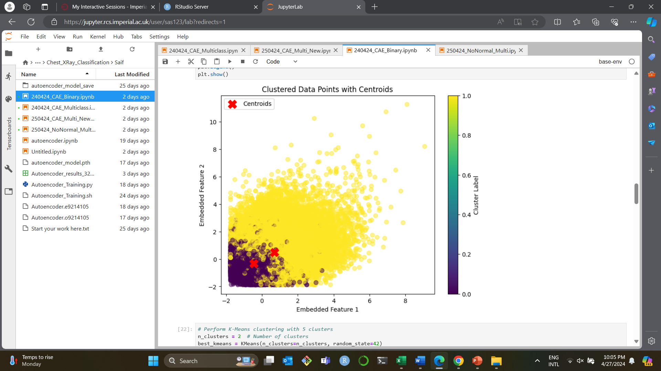
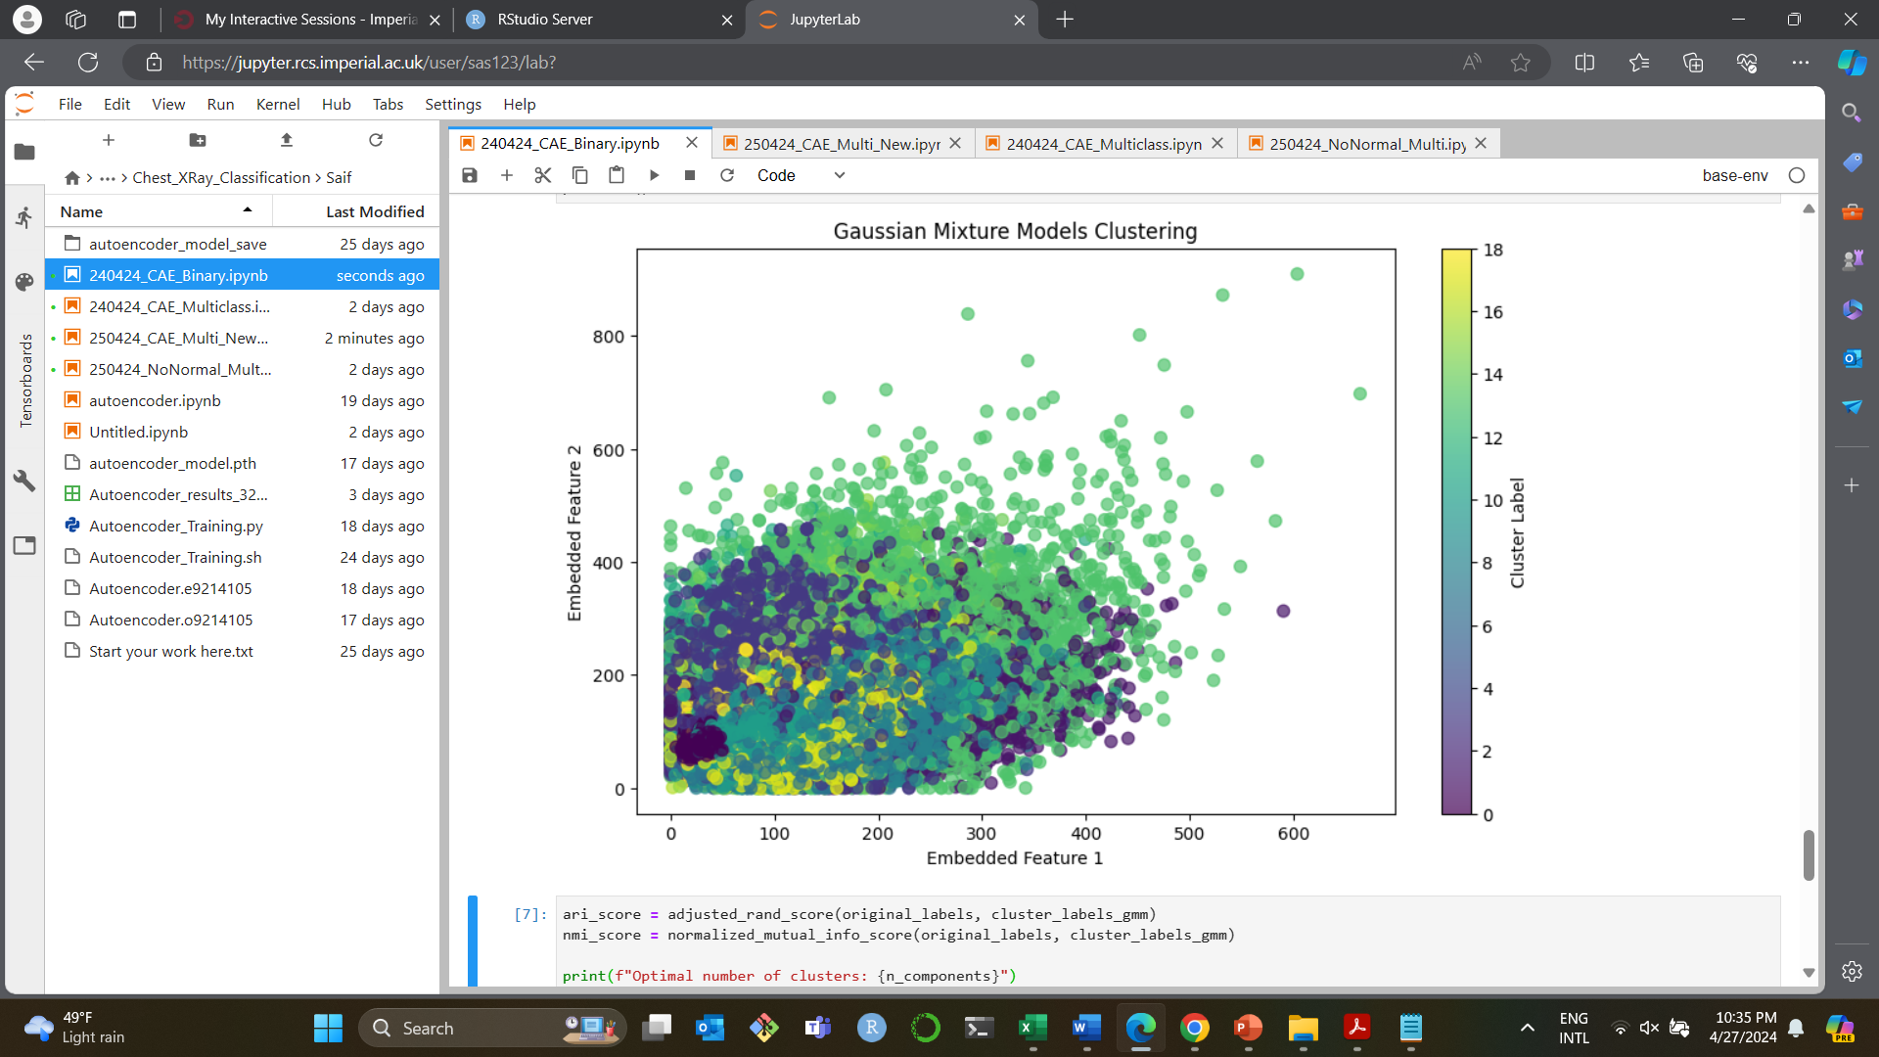
Autoencoder & Clustering
Binary Classification:
Optimal # of clusters = 2
Adjusted Rand Index (ARI) = 0.01
Normalized Mutual Information (NMI) = 0.00
Optimal # of clusters = 19
Adjusted Rand Index (ARI) = 0.01
Normalized Mutual Information (NMI) = 0.01
Notes:
Adjusted Rand Index (ARI):
Measures the similarity between two clusterings, considering all pairs of samples and counting pairs that are assigned in the same or different clusters in the predicted and true clusterings.
ARI ranges from -1 to 1, where 1 indicates perfect clustering agreement, 0 indicates random clustering, and negative values indicate clustering disagreement.
Normalized Mutual Information (NMI):
Measures the mutual information between the predicted and true clusterings, normalized to be in the range [0, 1].
NMI of 1 indicates perfect clustering agreement, and 0 indicates no mutual information (random clustering).

Slide 17
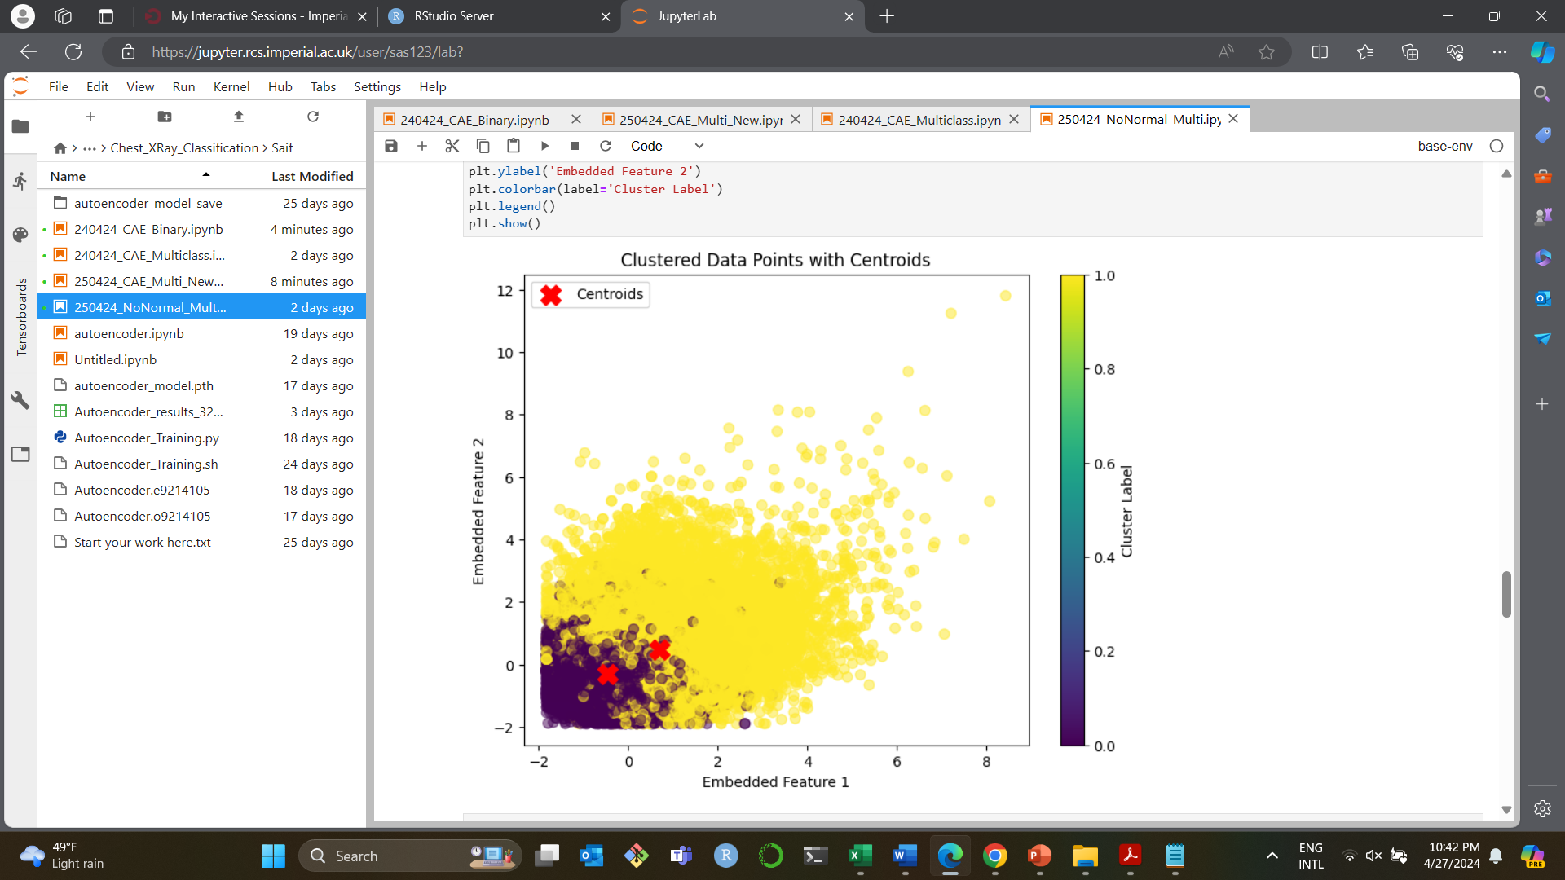
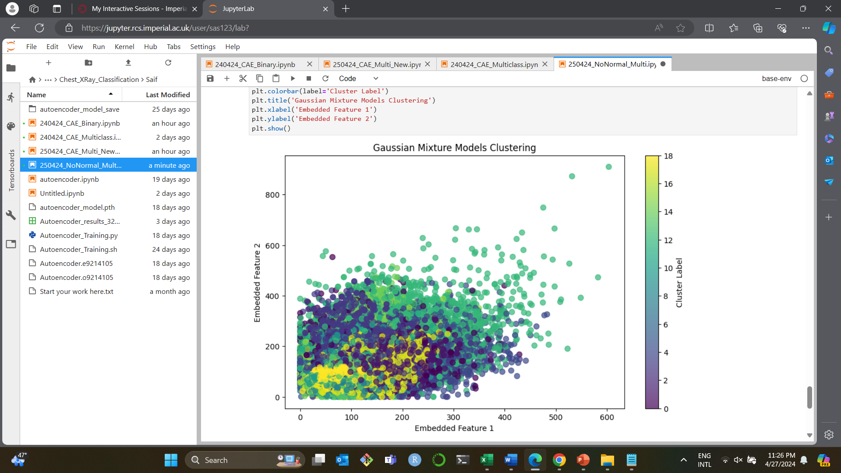
Autoencoder & Clustering
Multi-Class Classification:
Optimal # of clusters = 2
Adjusted Rand Index (ARI) = 0.01
Normalized Mutual Information (NMI) = 0.002
Optimal # of clusters = 19
Adjusted Rand Index (ARI) = 0.003
Normalized Mutual Information (NMI) = 0.006
Notes:
Adjusted Rand Index (ARI):
Measures the similarity between two clusterings, considering all pairs of samples and counting pairs that are assigned in the same or different clusters in the predicted and true clusterings.
ARI ranges from -1 to 1, where 1 indicates perfect clustering agreement, 0 indicates random clustering, and negative values indicate clustering disagreement.
Normalized Mutual Information (NMI):
Measures the mutual information between the predicted and true clusterings, normalized to be in the range [0, 1].
NMI of 1 indicates perfect clustering agreement, and 0 indicates no mutual information (random clustering).

Slide 18
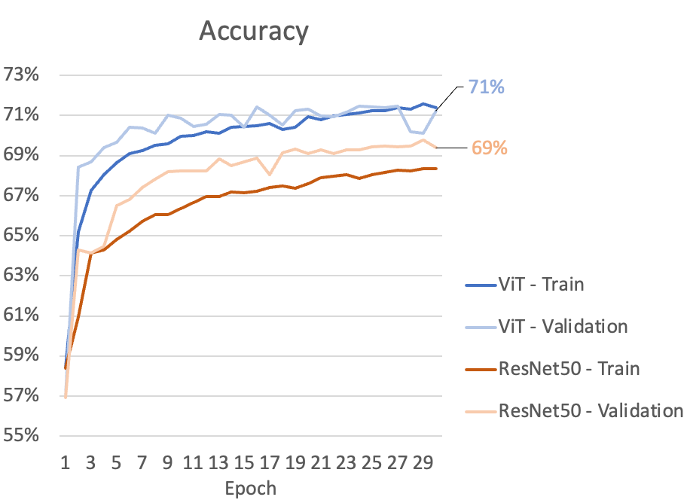
Binary Classification - ResNet50 & ViT
Test Set Performance
 | ViT | ResNet50
Accuracy | 0.70 | 0.68
AUC | 0.67 | 0.66
Recall/Sensitivity | 0.77 | 0.77
Precision | 0.74 | 0.73
F1-score | 0.76 | 0.75
Specificity | 0.58 | 0.54
Notes:
ResNet50 and ViT achieve a relatively stable performance after 30 epochs. ViT have better training and validation performance than ResNet50
Testset accuracy of is about 70% and 68%, 2% increase in accuracy for ViT than ResNet50
but the specificity is about 58% and 54% for each model.
ViT model are also having higher performance in all other measure metrics

Slide 19
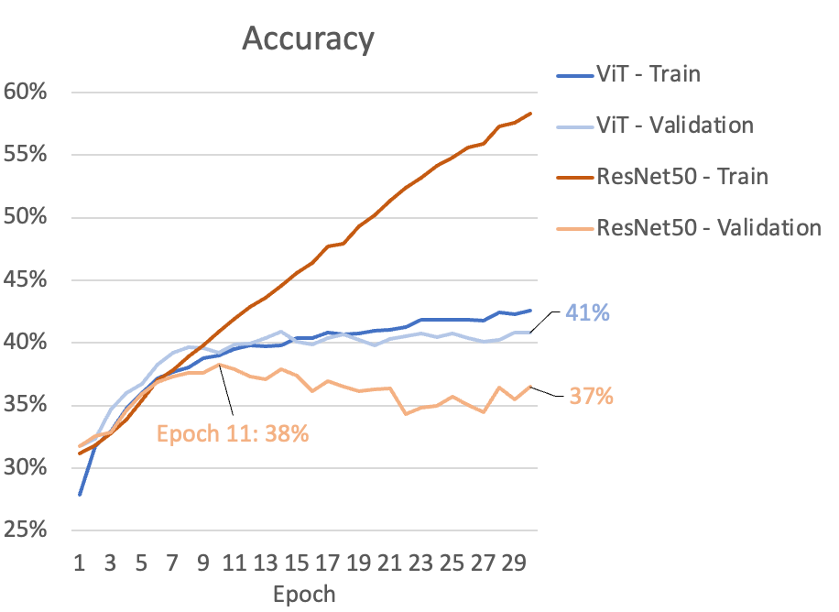
Multiclass Classification - ResNet50 & ViT
Notes:
This is the training and validation performance at each epoch. ViT does show a converged performance, but the ResNet 50 reach best validation performance at Epoch 11 and then gradually overfit. So we will use the model stopped at epoch 11 for testing

Slide 20
Multiclass Classification - ResNet50 & ViT
 | ViT |  |  |  | ResNet50
Accuracy | 0.38 |  |  |  | 0.34
 | Precision | Recall | F1-score | AUC | precision | recall | F1-score | AUC
Fluid overload | 0.35 | 0.38 | 0.37 | 0.60 | 0.35 | 0.23 | 0.28 | 0.56
Infection | 0.41 | 0.59 | 0.48 | 0.61 | 0.38 | 0.62 | 0.47 | 0.59
Mass like Lesions | 0.39 | 0.29 | 0.33 | 0.61 | 0.26 | 0.42 | 0.32 | 0.63
Parenchymal Disease | 0.30 | 0.28 | 0.29 | 0.62 | 0.18 | 0.08 | 0.11 | 0.53
Atelectasis | 0.32 | 0.26 | 0.29 | 0.59 | 0.32 | 0.18 | 0.23 | 0.56
Cardiomegaly | 0.39 | 0.37 | 0.38 | 0.67 | 0.35 | 0.29 | 0.32 | 0.63
Pneumothorax | 0.39 | 0.18 | 0.25 | 0.57 | 0.32 | 0.14 | 0.2 | 0.55
Pleural Thickening | 0.21 | 0.04 | 0.06 | 0.52 | 0.13 | 0.01 | 0.02 | 0.50
Notes:
Performance metric for Multiclassificaiton task.
Accuracy is quite poor. Only 38% for ViT and 34% for ResNet50.
Among all the diseases, Cardiomegaly has best AUC in both model. But in three other metrics, both models perfomance best for infection disease.
Both models have worst performance for Pleural thickening. AUC is only about 50% and recall is zero, so it is basically never correctly predict this disease at all.

Slide 21
Discussions & Conclusions

Slide 22
Discussion & Conclusions
Unsupervised Autoencoder and clustering did not achieve a desirable result
Encoder architecture is not performing well in feature selection
ViT has better performance compared to ResNET50 in both binary and multiclass classification of thoracic diseases - inline with current literature
Both models are underperforming in detecting true negative cases, yet ViT can better detect them
Overall performance of both models in multiclass classification needs a lot of improvement
can be owed to that images have multiple diagnoses
Cardiomegaly - though it has <1000 training images, it has the best AUC among all disease groups.
Possible reason: “an enlarged heart” is relatively easier to detect compared to other diseases

Slide 23
Limitations & Future Direction
Limitation:
Dataset is not large enough.
did not apply data augmentation since X-ray is not rotatable or shiftable
Future Work:
Enhance encoder architecture to better perform feature extraction
Include a weighted loss function to handle the difference in sample size in the multiclass groupings
Compile multiple X-ray datasets to overcome the low sample numbers in some of the classes
Try no-pretrained model if have larger dataset

Slide 24
Thank you!

Slide 25
Appendix 1
More background information
Computer vision - field of AI - enables computers to interpret and analyze visual information
In healthcare, it involves the use of algorithms to analyze medical images, aiding in clinical diagnosis & decision-making
Interpretation of X-rays, CT scans & MRIs
Detection and localization of abnormalities
Multiple advantages in medical diagnosis
Enhanced accuracy
Efficiency
Scalability

Slide 26
Appendix 2
Transfer Learning for ResNet50
Modified ResNet50
Based on ResNet50 pre-trained on the ImageNet-1k dataset.
From python package `timm`, including enhancements that boost accuracy and efficiency.
modify to match the binary class/ 8 disease classes

Slide 27
Appendix 3
ResNet50 & ViT Hyperparameters
Batch size: 128
Epoch: 30
Learning rate: 0.01

Slide 28
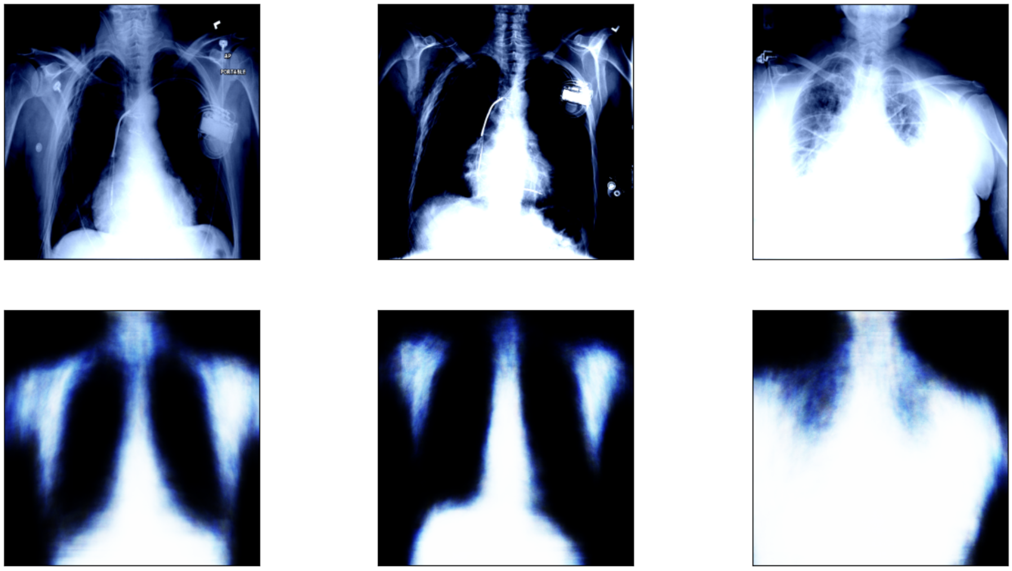
Appendix 4
Result: Autoencoder Reconstruction

Slide 29
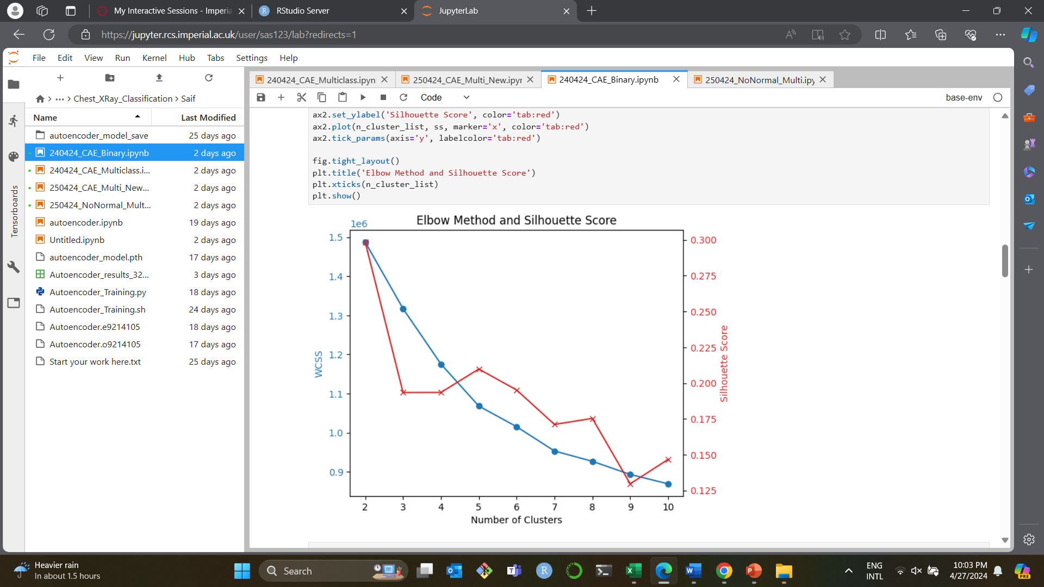
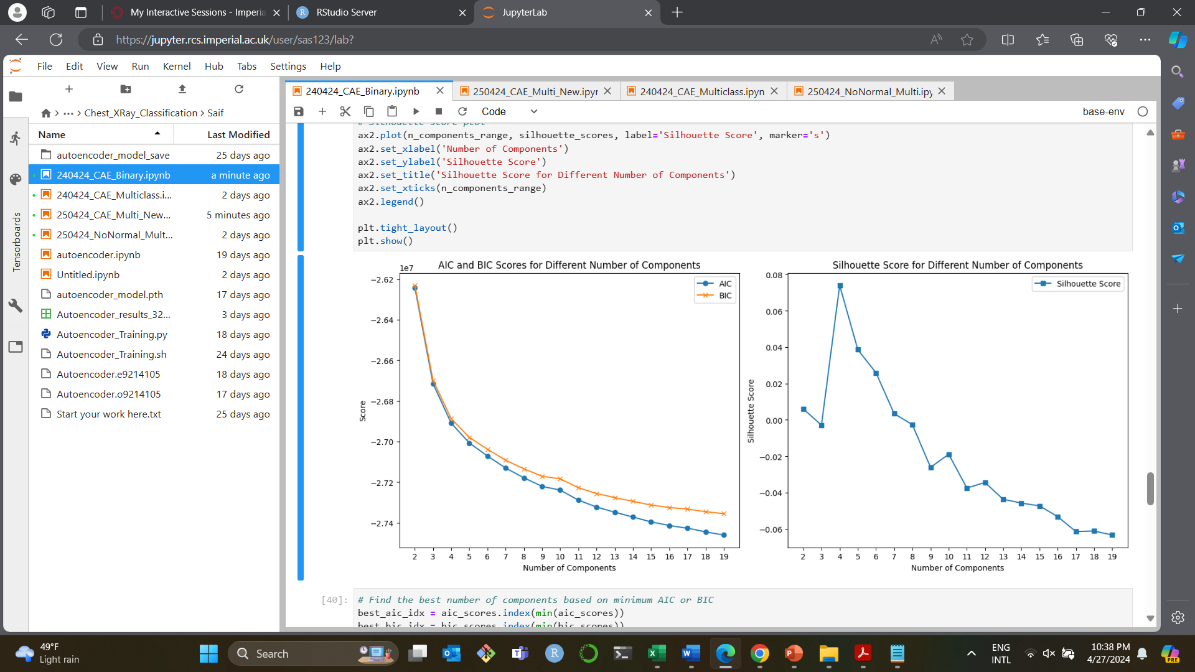
Appendix 5
Binary Classification: Kmeans
Binary Classification: GMM
Clustering Calibrition
Notes:
Adjusted Rand Index (ARI):
Measures the similarity between two clusterings, considering all pairs of samples and counting pairs that are assigned in the same or different clusters in the predicted and true clusterings.
ARI ranges from -1 to 1, where 1 indicates perfect clustering agreement, 0 indicates random clustering, and negative values indicate clustering disagreement.
Normalized Mutual Information (NMI):
Measures the mutual information between the predicted and true clusterings, normalized to be in the range [0, 1].
NMI of 1 indicates perfect clustering agreement, and 0 indicates no mutual information (random clustering).

Slide 30
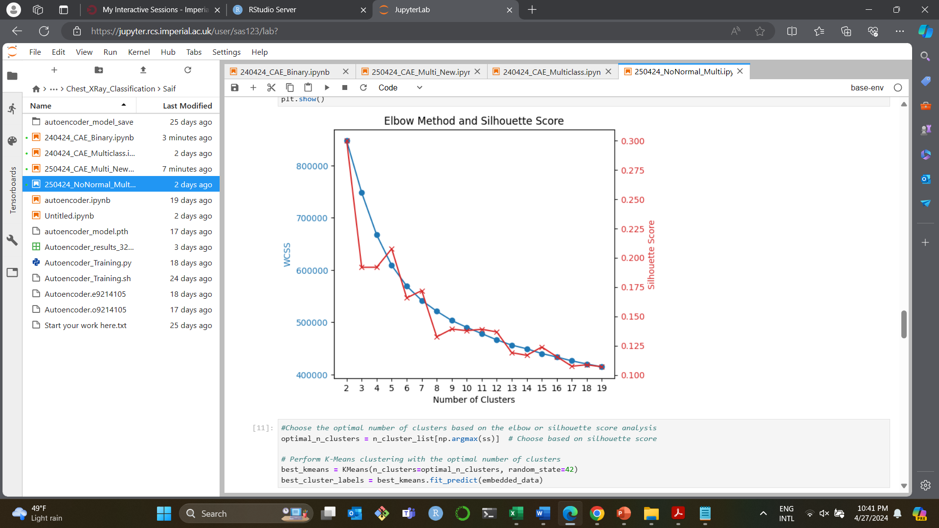
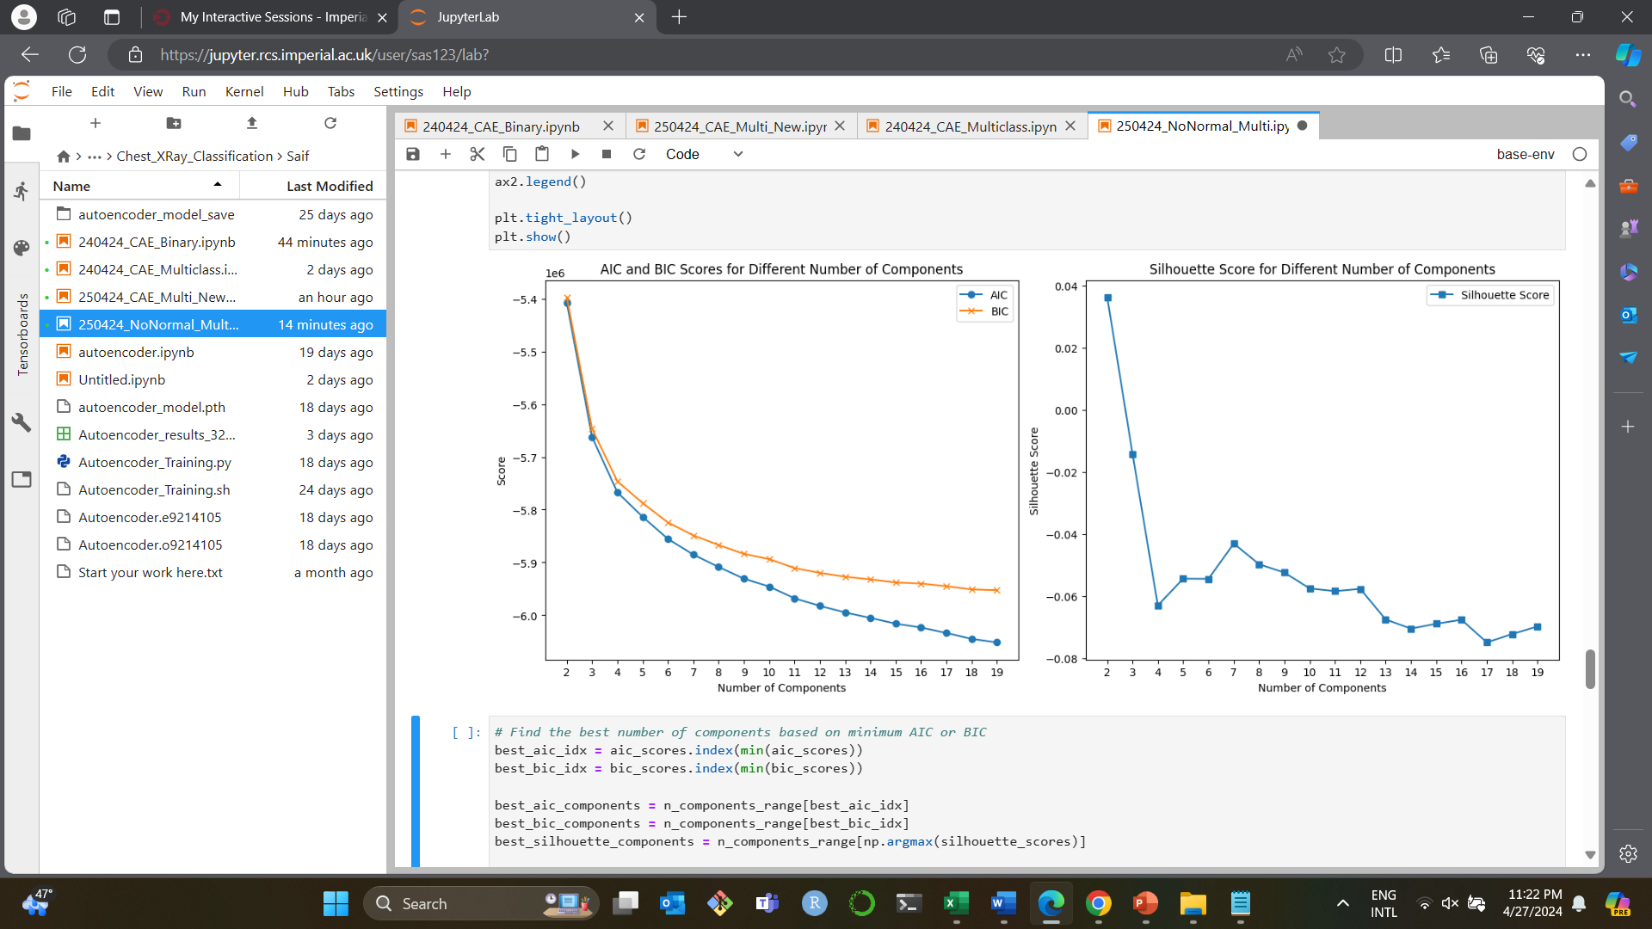
Appendix 5
Multi-Class Classification: Kmeans
Multi-Class Classification: GMM
Clustering Calibrition
Notes:
Adjusted Rand Index (ARI):
Measures the similarity between two clusterings, considering all pairs of samples and counting pairs that are assigned in the same or different clusters in the predicted and true clusterings.
ARI ranges from -1 to 1, where 1 indicates perfect clustering agreement, 0 indicates random clustering, and negative values indicate clustering disagreement.
Normalized Mutual Information (NMI):
Measures the mutual information between the predicted and true clusterings, normalized to be in the range [0, 1].
NMI of 1 indicates perfect clustering agreement, and 0 indicates no mutual information (random clustering).

Slide 31
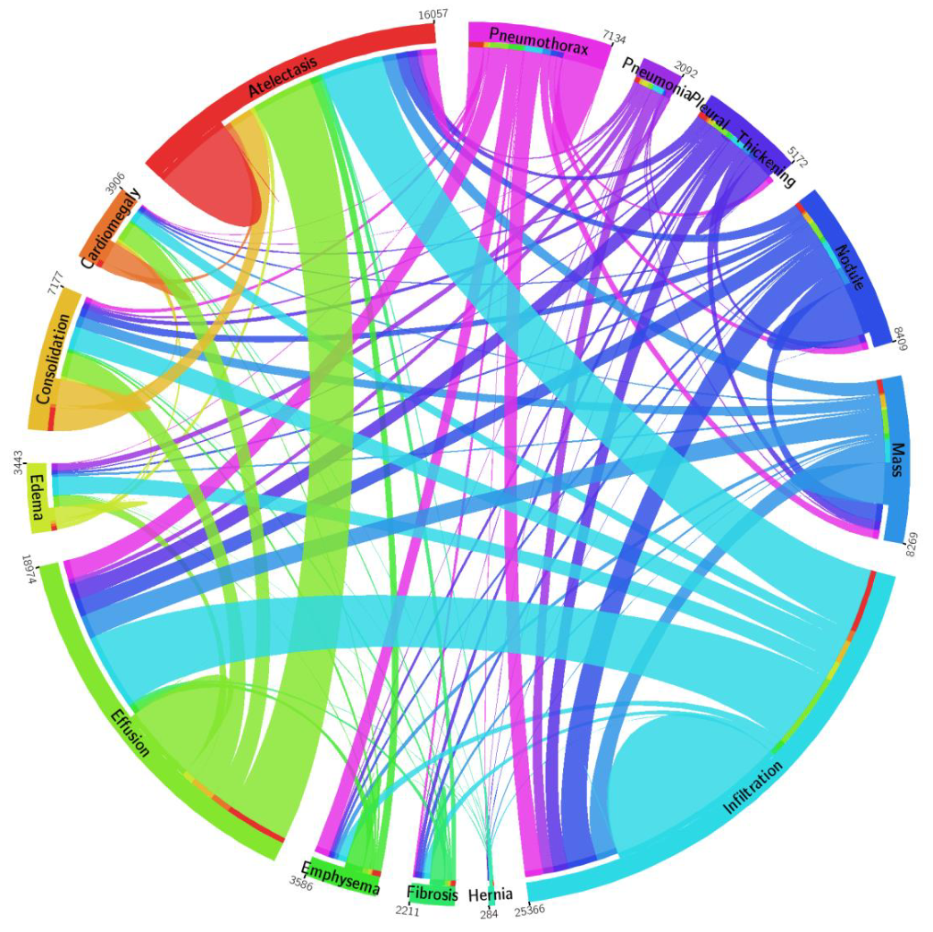
Appendix 6
Multiple diagnosis situation for each image

